Slide 1
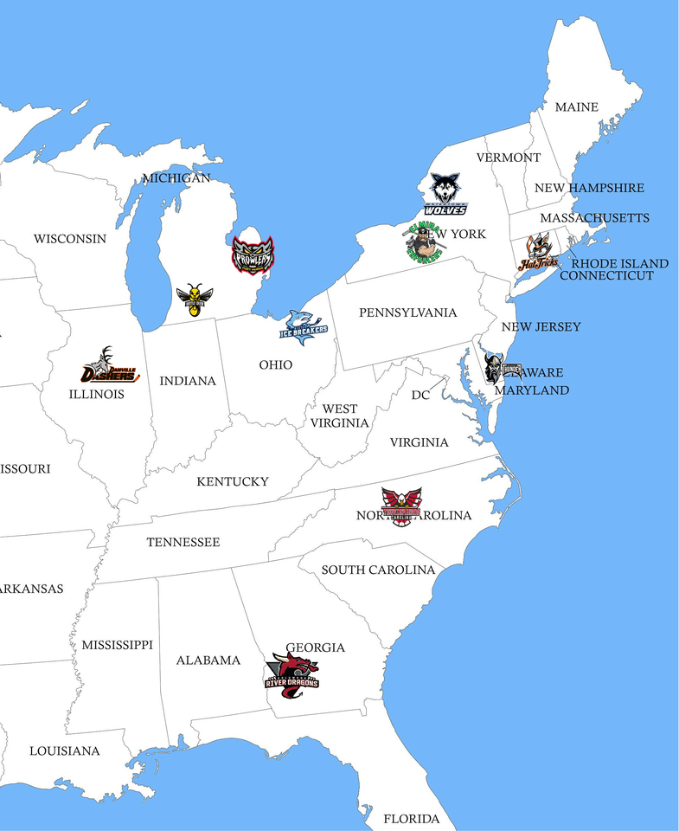
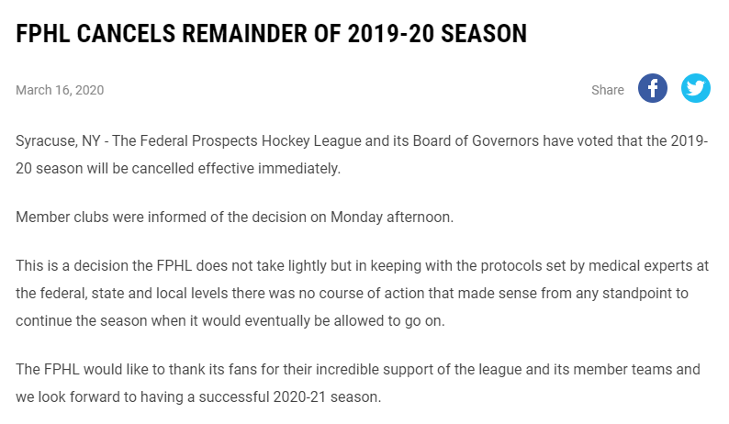
https://digitalshift-assets.sfo2.cdn.digitaloceanspaces.com/pw/603c74d0-0ed2-4d3f-8171-b447f9398da4/p-49390168-9856-4818-b7fb-80d98ac8fbd8/1564016554-full.jpg

Slide 2
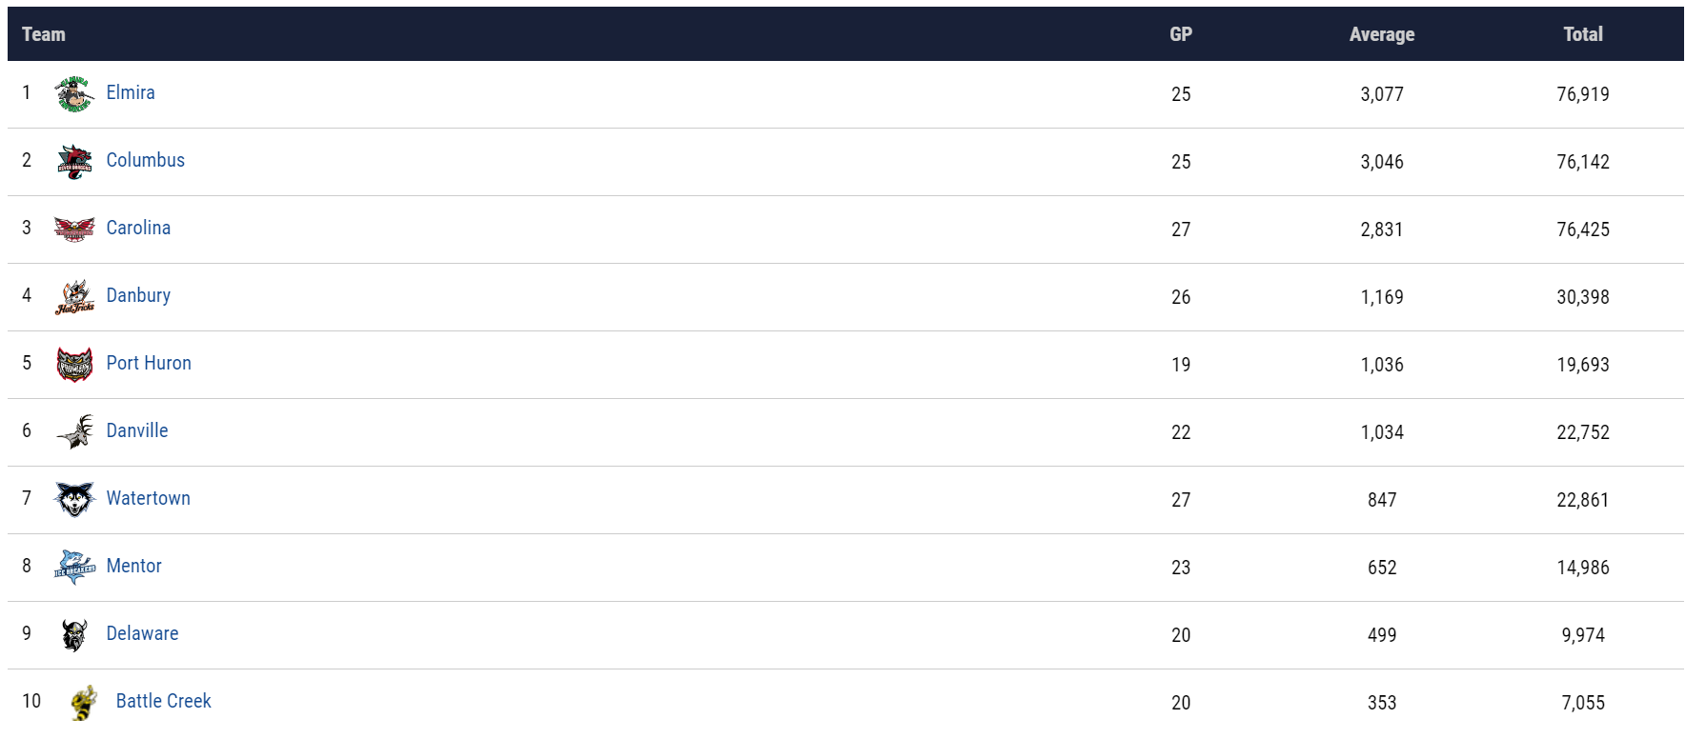
The Bigger the City, the more the attendance... But note: season was cancelled early !

Slide 3
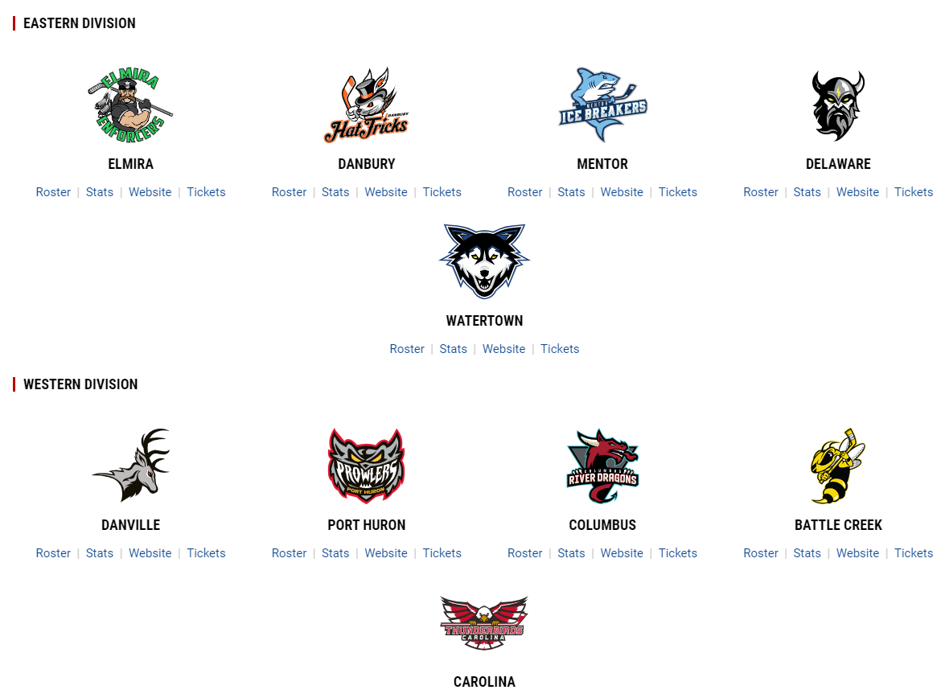

Slide 4
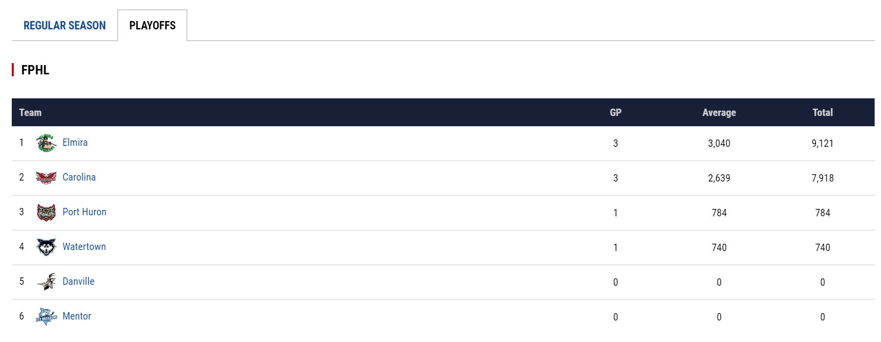
2018/2019

Slide 5
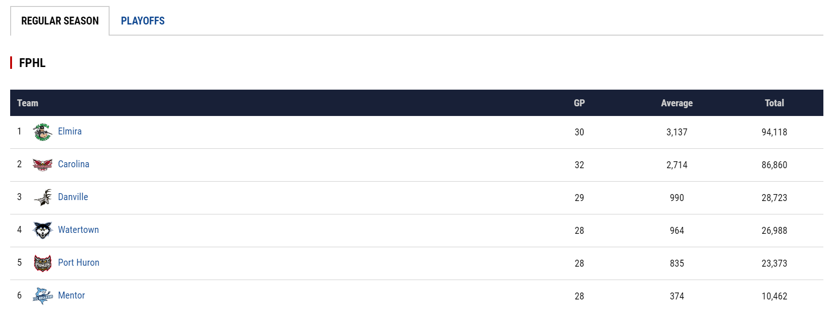
2018/2019

Slide 6
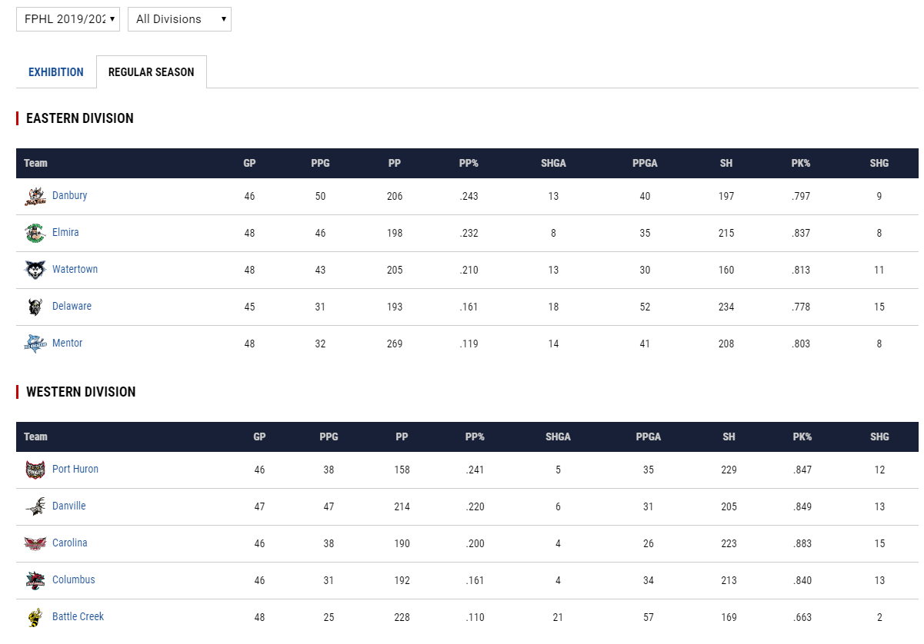

Slide 7
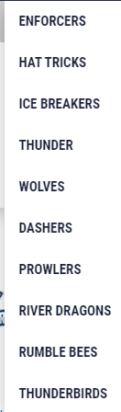

Slide 8
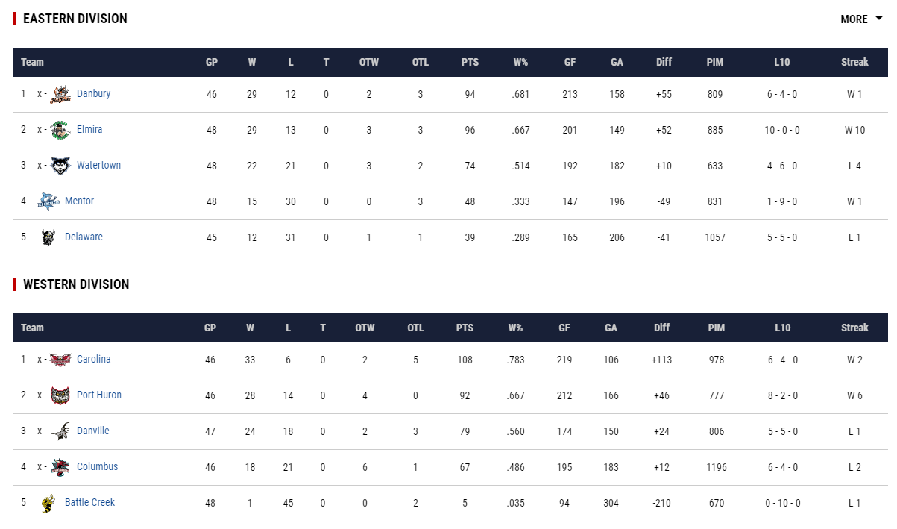

Slide 9
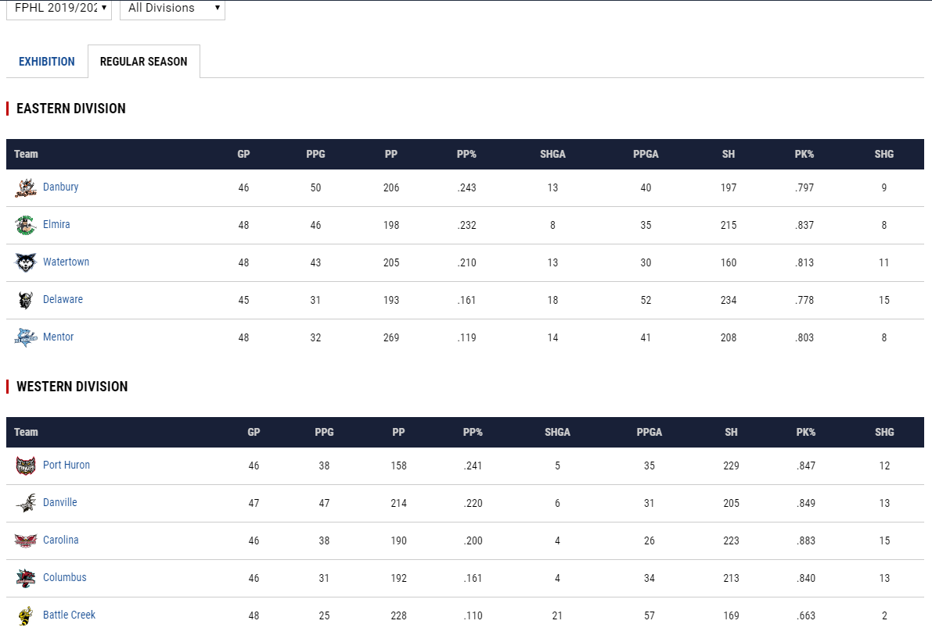

Slide 10
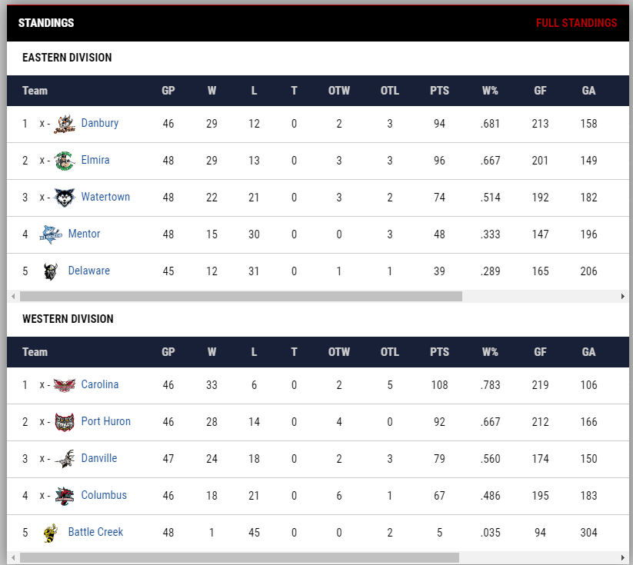

Slide 11
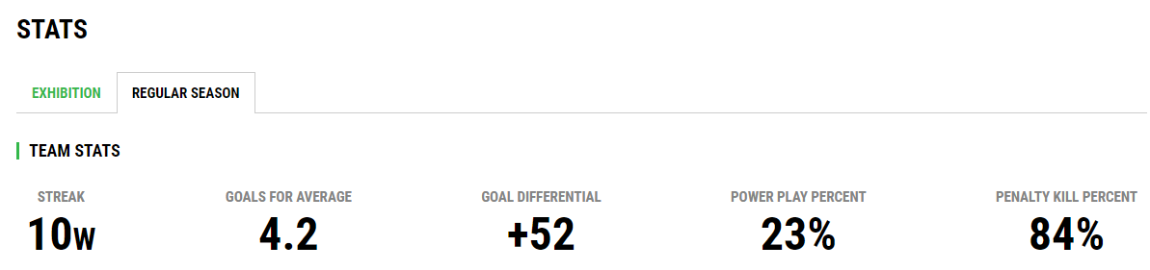

Slide 12
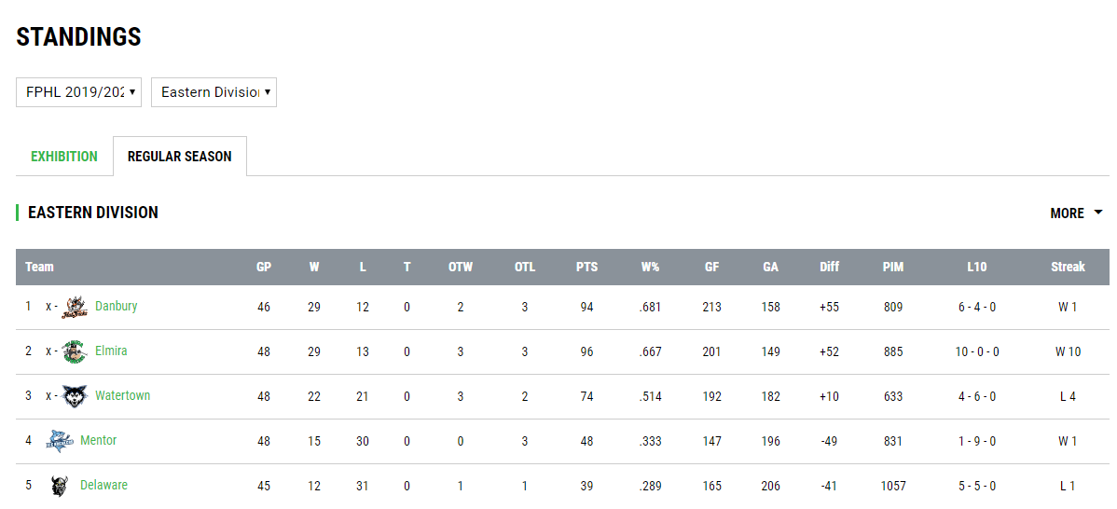

Slide 13
